Slide 1
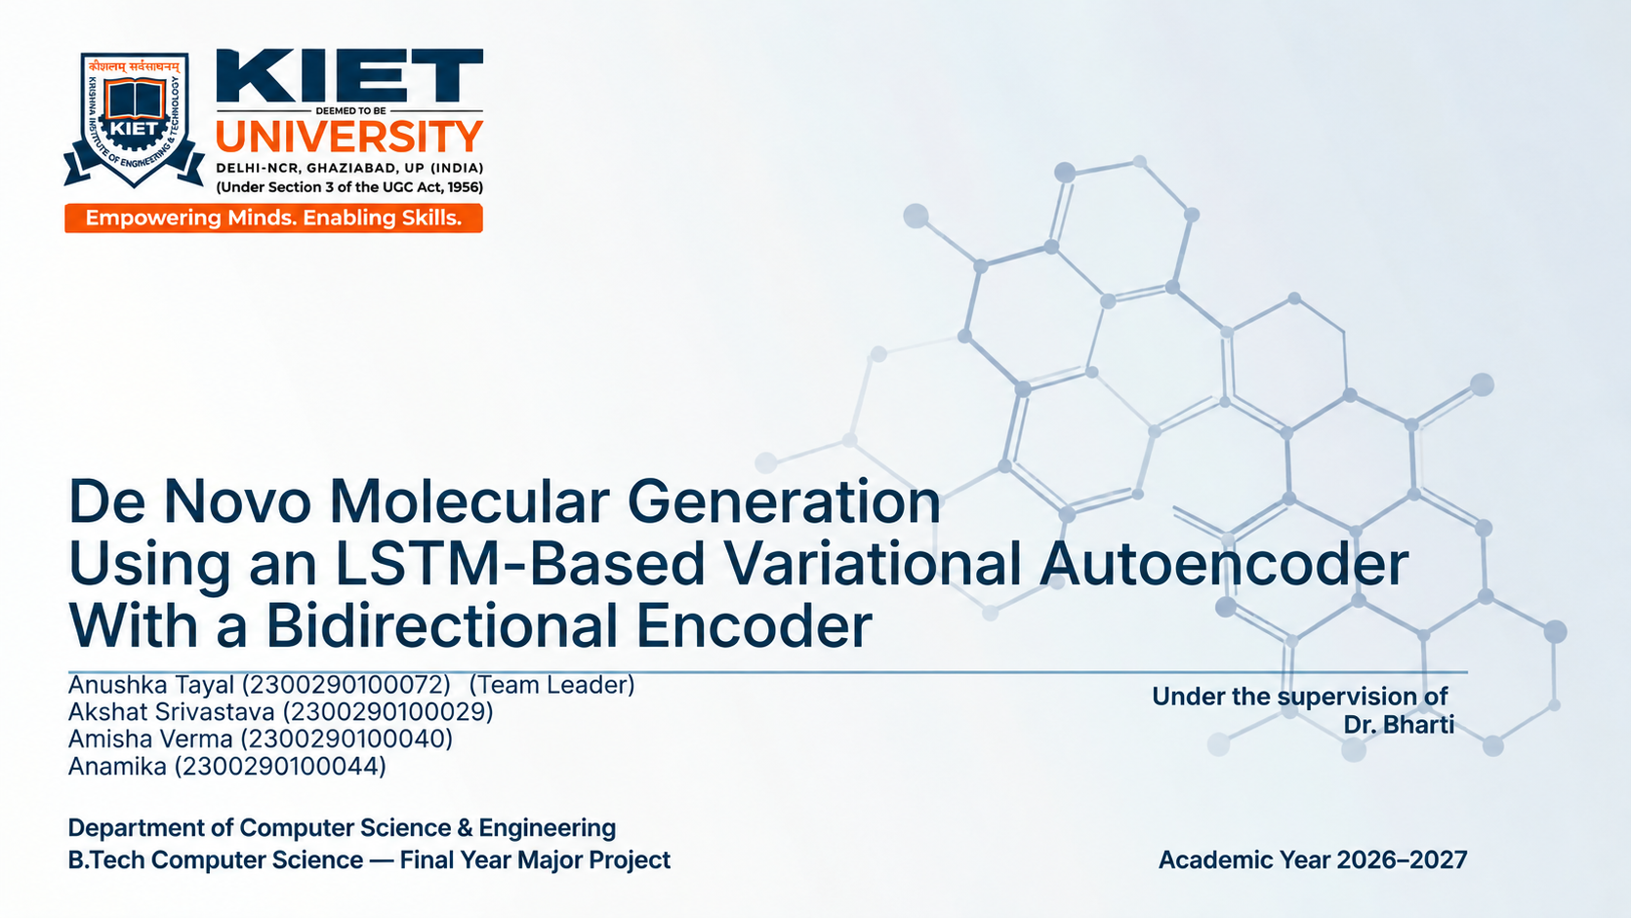

Slide 2
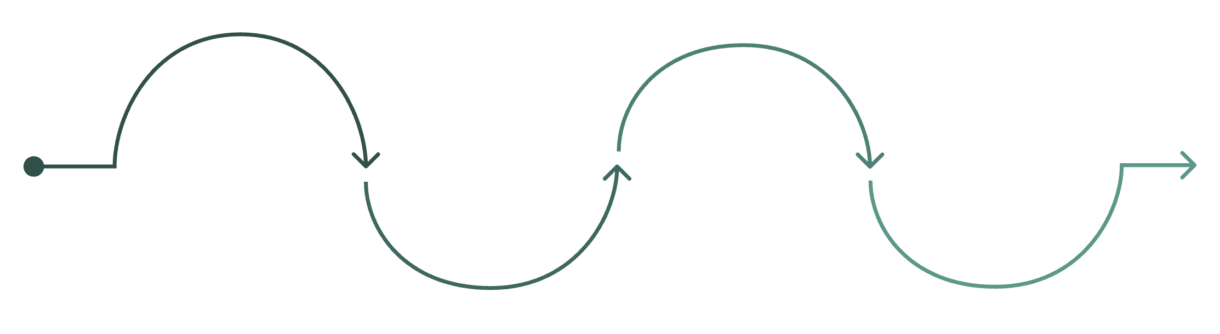
Problem Statement & Project Objectives
Problem Statement
Project Objectives
1
Vast Chemical Space
1
Develop a Generative Model
The chemical space for drug discovery is huge and discrete, making exhaustive screening impractical.
Build an LSTM-based VAE for de novo molecular generation from SMILES.
2
Improve Molecular Representation
2
Limited Exploration
Use a Bidirectional LSTM encoder for richer sequence-level representations.
Traditional screening methods reach only a small fraction of useful molecular structures.
3
Improve Latent-Space Utilization
3
Generative Modeling Challenges
Apply step-wise latent injection and β-KL annealing during decoding.
SMILES models can generate invalid sequences, and recurrent VAEs may suffer from posterior collapse.
4
Evaluate Generated Molecules
Assess validity, uniqueness, novelty, diversity, Lipinski compliance, QED, and SA.
Exploration
Overcoming Bottlenecks
AI Design
.
Creation
.

Slide 3
Literature Review & Gap Analysis
Approach | Representative Models | Strength | Key Limitation
Sequence-Based VAE | VAE, Re-balanced VAE, SD-VAE | Learns continuous latent representations from SMILES sequences | Prone to posterior collapse and poor latent-space utilization
Conditional / β-VAE | CVAE, β-VAE | Incorporates molecular-property information; enables property-aware generation | Balancing reconstruction quality, KL regularization, and property learning is challenging
Graph-Based Generation | JT-VAE, MolGAN, GraphAF, GraphDF | Captures molecular connectivity directly via graph-based representations | Introduces greater architectural and computational complexity
Flow / Hierarchical Models | MoFlow, MolHF | Provide powerful structured approaches for molecular generation | Require more complex architectures and training procedures
Identified Research Gap
Sequence-based VAEs can suffer from poor latent-space utilization and KL-regularization difficulties.
Recurrent decoders may ignore latent variables, leading to posterior collapse.
Graph-based approaches improve structural validity but introduce greater architectural complexity.
Therefore, the project investigates a sequence-based framework combining bidirectional encoding + step-wise latent injection + β-KL annealing + property prediction.

Slide 4
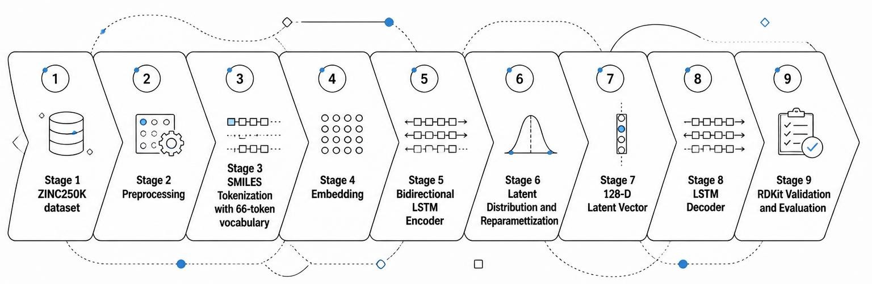
Proposed Methodology
Identified Research Gap
End-to-end generation pipeline from raw ZINC250K data through preprocessing, encoding, latent sampling, autoregressive decoding, and molecular evaluation.
Preprocessing: RDKit validation, canonical SMILES conversion, duplicate removal.
Representation: Regex-based SMILES tokenizer with 66 tokens, including special tokens.
Latent Learning: Two-layer Bidirectional LSTM encoder maps molecular sequences into a 128-dimensional latent distribution.
Generation: Latent sampling followed by autoregressive LSTM decoding with temperature scaling and Top-p sampling.
Why Bidirectional Encoding?
Forward + backward context captures richer molecular sequence structure, improving latent-space learning and downstream generation quality.

Slide 5
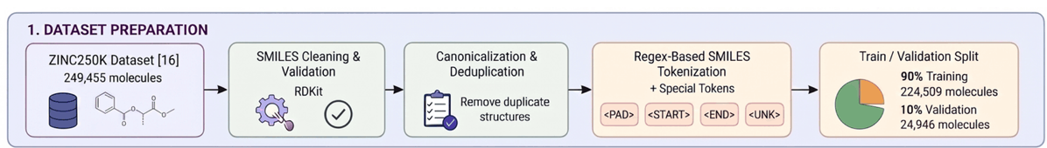
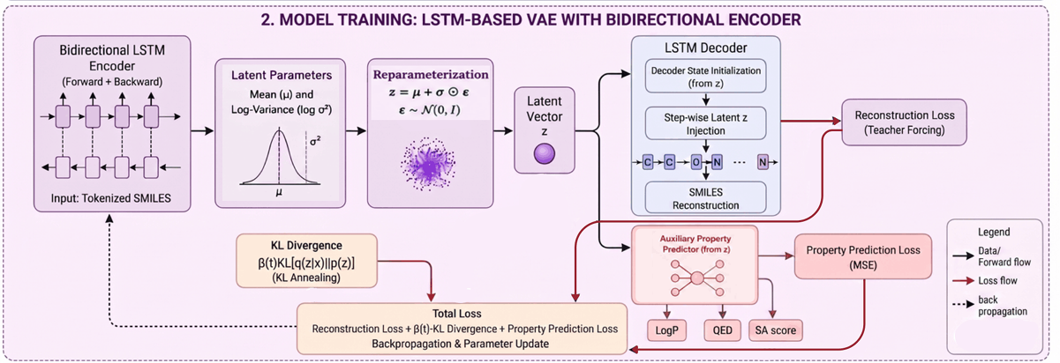
Data Preparation & Preprocessing
Model Training
Technical Specifications:
Embedding dimension: 256
Encoder: 2-layer Bidirectional LSTM
Latent dimension: 128
Decoder: 2-layer LSTM
Optimizer: AdamW
Learning rate: 0.001
Batch size: 128
Training: 15 epochs

Slide 6
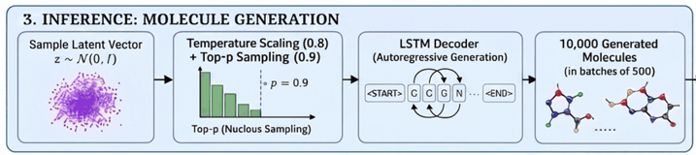

Training Objective and Molecule Generation
Training Loss
SMILES Generation and Evaluation
Reconstruction Loss: Token-level cross-entropy for SMILES reconstruction
KL Loss: Regularizes latent distribution toward standard normal
Property Loss: Auxiliary prediction of LogP, QED, and SA
β-KL Annealing: β increases gradually to 0.05, reducing excessive regularization during early training and mitigating posterior collapse.
Generation Protocol
LSTM Decoder · Temperature: 0.8 · Top-p: 0.9
RDKit validation applied to all outputs
10,000 molecules generated in batches of 500
Evaluation:
Uniqueness, Novelty
Diversity using Tanimoto distance
Lipinski’s rule of Five
Quantitative Estimate of drug-likeness(QED)
Synthetic Accessibility score
Generation Quality
Drug Likeness

Slide 7
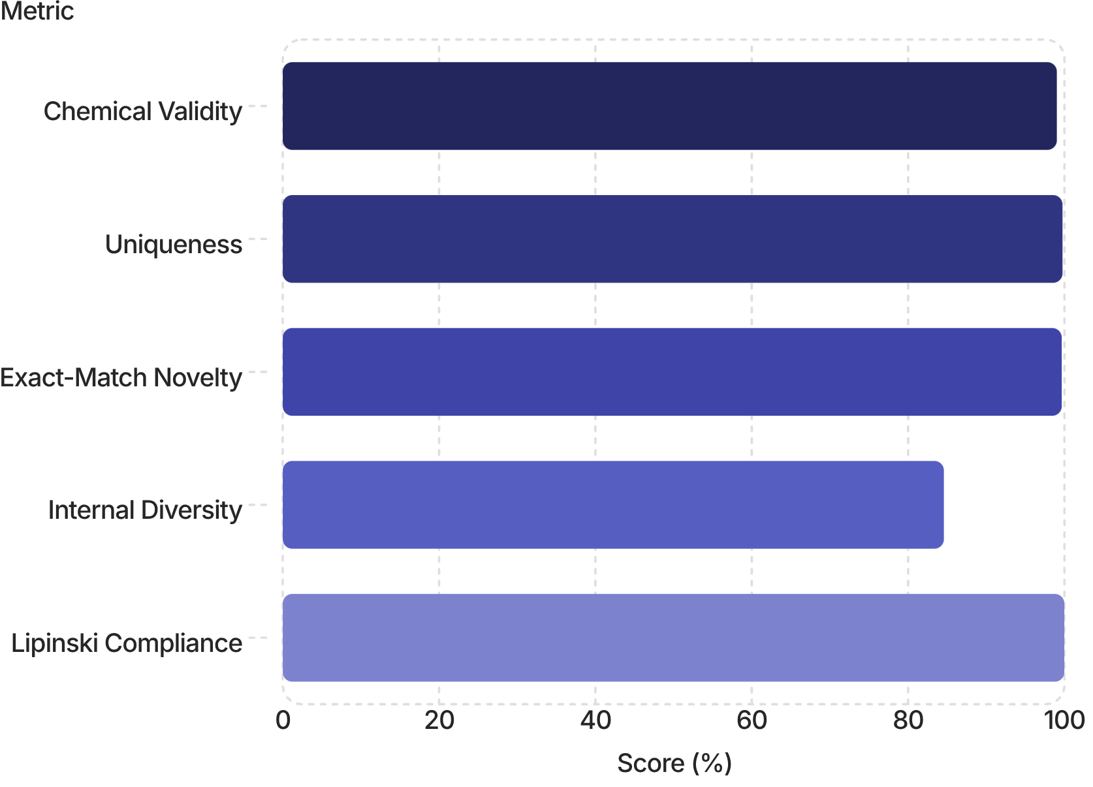


Generation Quality: Quantitative Results
99.02%
99.75%
Chemical Validity
Uniqueness
99.65%
84.57%
Exact-Match Novelty
Internal Diversity
Secondary Metrics
Mean QED: 0.7719
Mean SA: 2.63
Lipinski Compliance: 99.98%
Generated molecules exhibit high chemical validity while maintaining strong uniqueness, novelty, and internal diversity. Drug-likeness metrics reflect computational estimates — not experimentally validated biological activity.

Slide 8
Training Behavior and Model Interpretation
Training loss decreased from 0.9644 → 0.6604
validation loss from 0.7097 → 0.6331
Reconstruction loss declined from 0.9017 → 0.5899
KL loss from 4.5323 → 0.7476
Intermediate epoch values are interpolated for
visualization.

Slide 9
Research Contributions & Significance
1
2
Improved Sequence Representation
Latent-Space Utilization
3
4
Investigates bidirectional sequence encoding for capturing richer contextual information from molecular SMILES, enabling more expressive molecular representations.
Addresses weak latent utilization in recurrent VAE-based molecular generation through improved decoder conditioning and KL-annealing strategies.
Integrated Property Learning
Chemical-Space Exploration
Incorporates auxiliary prediction of molecular properties into the learning objective, connecting the latent representation with molecular characteristics.
Provides a computational approach for exploring new molecular structures rather than relying only on conventional screening of existing compounds.
"Generative molecular modeling does not replace experimental drug discovery; it can support the early-stage exploration and prioritization
of candidate structures."

Slide 10
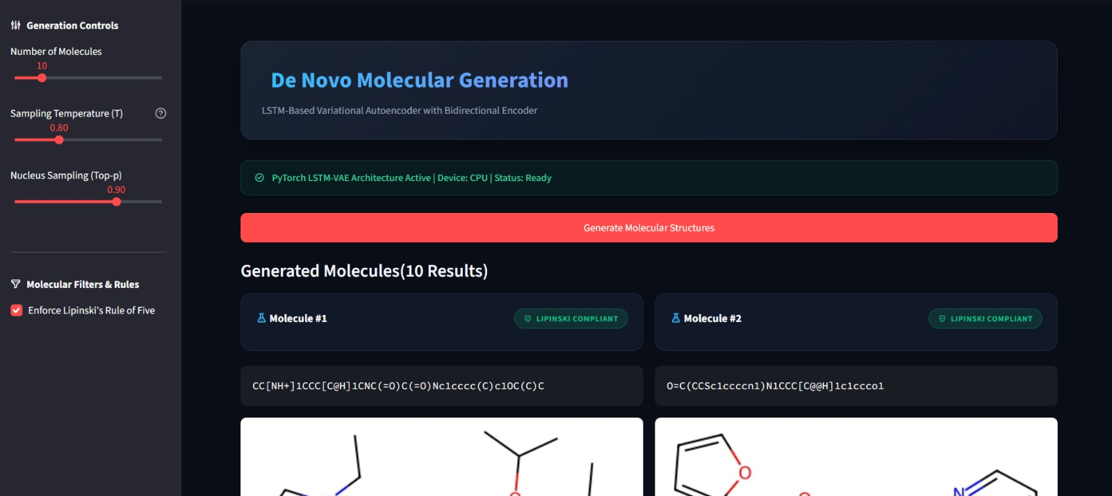
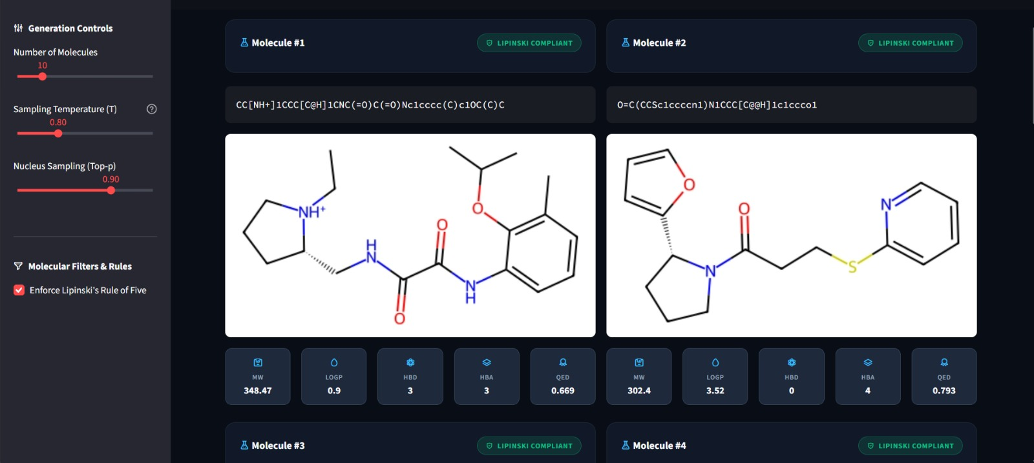
Demonstration

Slide 11

Future Scope
Computational Property Estimates
QED, SA, and LogP are only in silico proxies.
Lack of Experimental Validation
Nothing has been synthesized or tested in the lab.
No Biological Activity Evidence
No biological activity or therapeutic effect is shown.
Synthesizability & Practical Feasibility
Feasibility still needs further evaluation.
Computational molecules still need chemical, biological, and experimental validation before drug-discovery claims can be made.

Slide 12
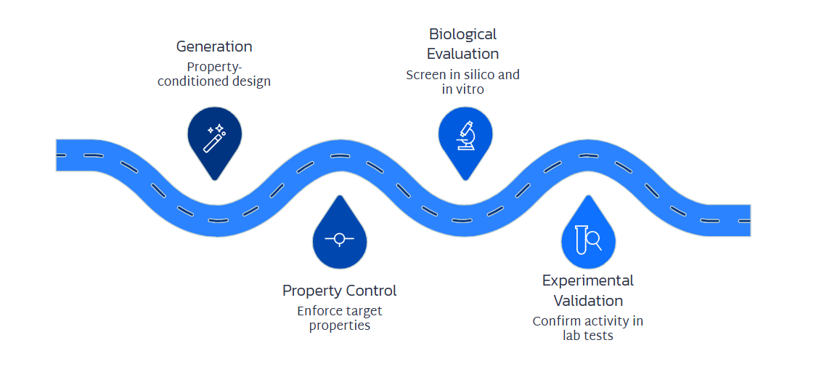
Future Scope & Conclusion
Conclusion
The LSTM-based VAE with a bidirectional encoder is an effective framework for de novo molecular generation, the creation of novel molecules, but its outputs must still be supported by validation to ensure chemical and biological relevance.

Slide 13
REFERENCES
X. Tang, H. Dai, E. Knight, F. Wu, Y. Li, T. Li, and M. Gerstein, “A survey of generative AI for de novo drug design: New frontiers in molecule and protein generation,” Briefings in Bioinformatics, vol. 25, no. 4, Art. no. bbae338, 2024, doi: 10.1093/bib/bbae338.
R. Gómez-Bombarelli, J. N. Wei, D. Duvenaud, J. M. Hernández-Lobato, B. Sánchez-Lengeling, D. Sheberla, J. Aguilera-Iparraguirre, T. D. Hirzel, R. P. Adams, and A. Aspuru-Guzik, “Automatic chemical design using a data-driven continuous representation of molecules,” ACS Central Science, vol. 4, no. 2, pp. 268–276, 2018, doi: 10.1021/acscentsci.7b00572.
A. Gupta, A. T. Müller, B. J. H. Huisman, J. A. Fuchs, P. Schneider, and G. Schneider, “Generative recurrent networks for de novo drug design,” Molecular Informatics, vol. 37, nos. 1–2, Art. no. 1700111, 2018, doi: 10.1002/minf.201700111.
M. H. S. Segler, T. Kogej, C. Tyrchan, and M. P. Waller, “Generating focused molecule libraries for drug discovery with recurrent neural networks,” ACS Central Science, vol. 4, no. 1, pp. 120–131, 2018, doi: 10.1021/acscentsci.7b00512.
C. Yan, S. Wang, J. Yang, T. Xu, and J. Huang, “Re-balancing variational autoencoder loss for molecule sequence generation,” in Proc. 11th ACM Int. Conf. Bioinformatics, Computational Biology and Health Informatics (BCB), 2020, pp. 1–7, doi: 10.1145/3388440.3412458.
J. Lim, S. Ryu, J. W. Kim, and W. Y. Kim, “Molecular generative model based on conditional variational autoencoder for de novo molecular design,” Journal of Cheminformatics, vol. 10, Art. no. 31, 2018, doi: 10.1186/s13321-018-0286-7.
R. J. Richards and A. M. Groener, “Conditional β-VAE for de novo molecular generation,” arXiv preprint arXiv:2205.01592, 2022, doi: 10.48550/arXiv.2205.01592.
W. Jin, R. Barzilay, and T. Jaakkola, “Junction tree variational autoencoder for molecular graph generation,” in Proc. 35th Int. Conf. Machine Learning, vol. 80, 2018, pp. 2323–2332

Slide 14


THANK
YOU

